Slide 1
Prototyping clinical applications with PLUS and SlicerIGT
Andras Lasso, Tamas Ungi, Csaba Pinter, Tomi Heffter, Adam Rankin, Gabor Fichtinger
Queen’s University, Canada
Email: gabor@cs.queensu.ca
PLUS http://www.plustoolkit.org
SlicerIGT http://www.slicerigt.org
Perk Lab http://perk.cs.queensu.ca

Slide 2
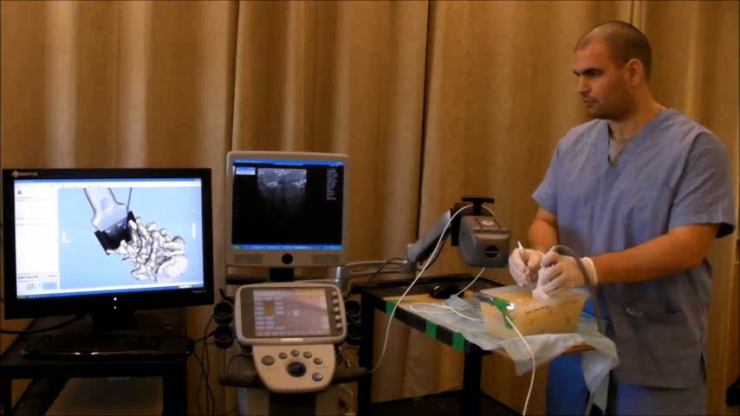
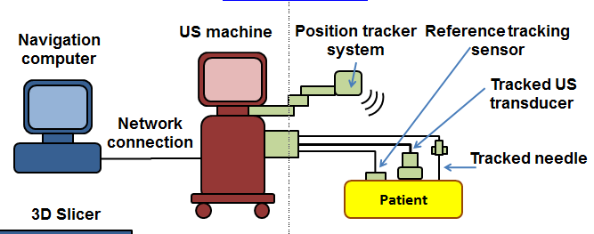
Tracked ultrasound navigation
Problem:
Increasingly popular, but difficult to learn
Demands substantial engineering effort
Our Approach:
Platform for prototyping applications
Predictable performance
Invariant to the clinical application
Notes:
why we do it: we hate seeing duplicate efforts and low quality research infrastructure;
it doesn’t worth the effort to implement a decent infrastructure for a single project, so one either have to rely on a crappy infrastructure or collaborate with others to create a good one
how we do it: best practices taken from Slicer and industry
how can we give this away all these for free, how we get funding: explaining how we have our funding now and how we expect to get small contribution from projects that use the infrastructure in the future

Slide 3
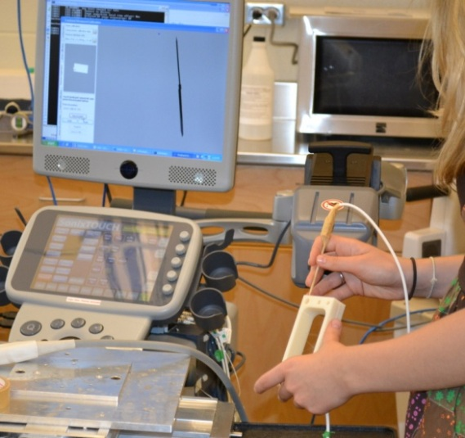
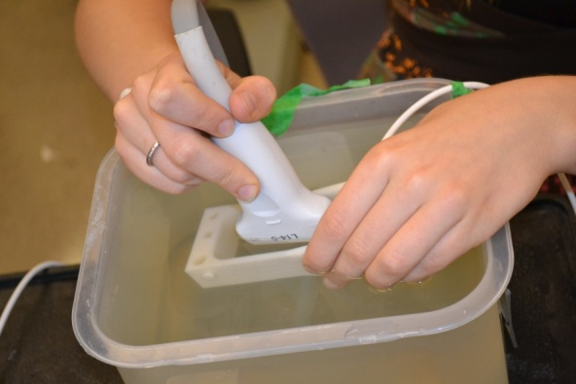
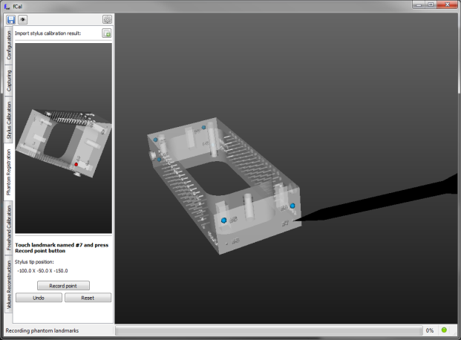
Calibration
Compute the US IMAGE to NEEDLE TIP transform
PHANTOM
STYLUS TIP
PROBE
US IMAGE
REFERENCE
STYLUS REF
NEEDLE TIP
TRACKER
NEEDLE REF

Slide 4
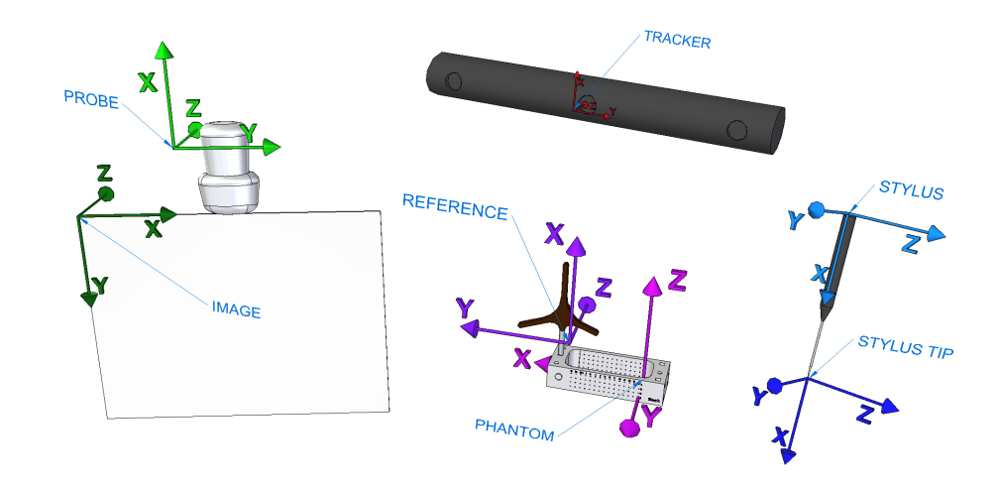
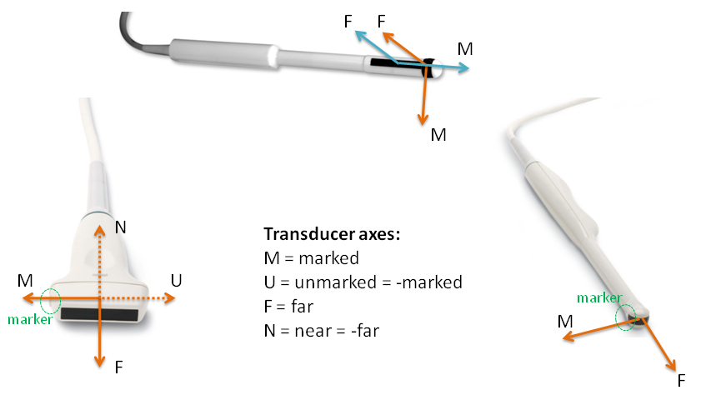
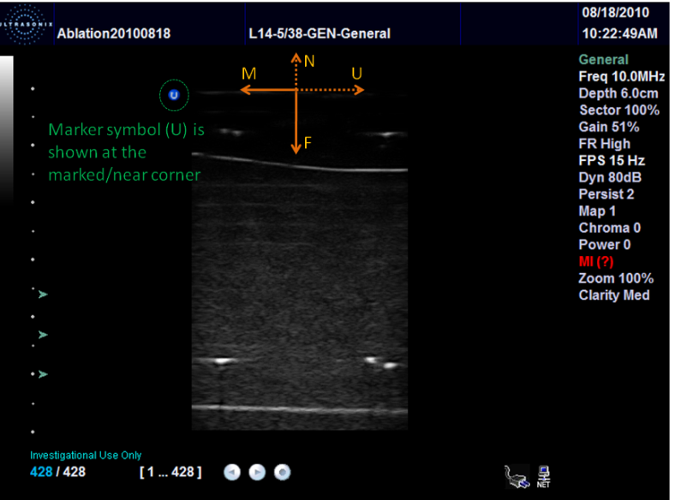
Explosion of chances for error

Slide 5
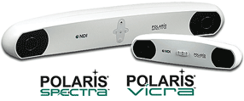
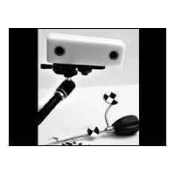
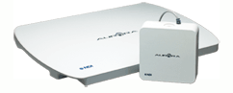
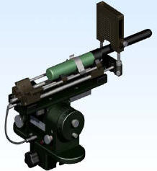
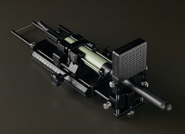
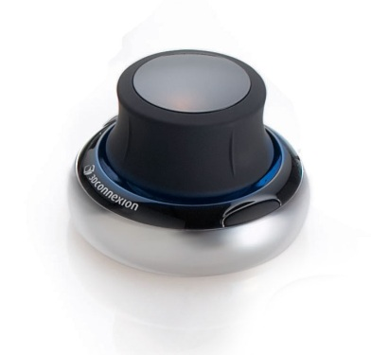
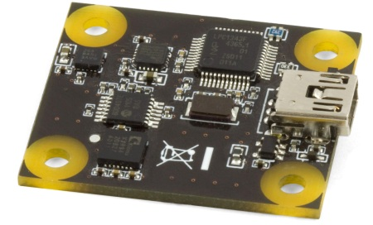
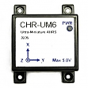
Data acquisition - tracking
Ascension EM tracker
NDI Aurora, Polaris, and Certus optical and electromagnetic trackers
Claron MicronTracker optical tracker
Brachy steppers (CMS Accuseed, Burdette Medical systems, CIVCO)
PhidgetSpatial inertial measurement device
CHRobotics inertial measurement device
3dConnexion SpaceNavigator 3D mouse
OpenIGTLink (for BrainLab, Siemens MRI scanners, and other compatible devices)
Software devices: file source, US simulator

Slide 6
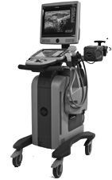
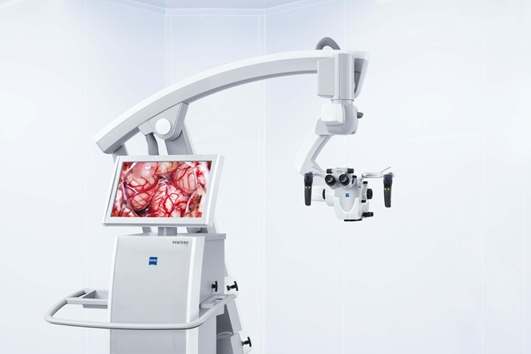
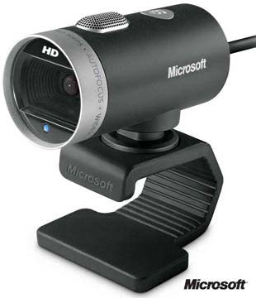
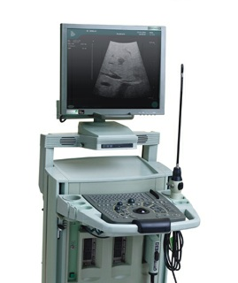
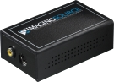
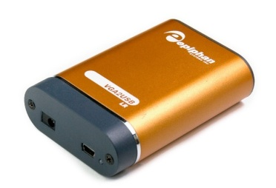
Data acquisition - imaging
Ultrasonix: B-mode & RF (through research interface)
BK ProFocus: B-mode & RF (through research interface)
Epiphan and ImagingControl framegrabbers
Microsoft Media Foundation and Video for Windows compatible devices (framegrabbers, surgical microscopes, endoscopes, webcams, etc.)
OpenIGTLink (for MUSiiC, Siemens MRI scanners, and other compatible devices)
Other software devices: file source, US simulator

Slide 7
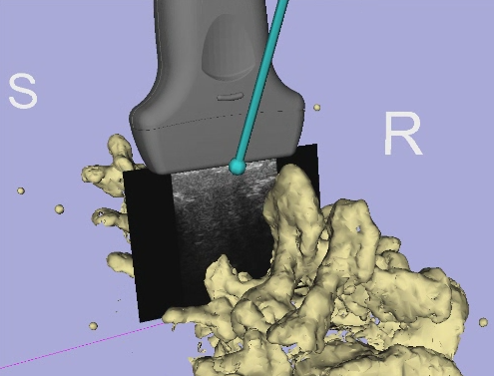
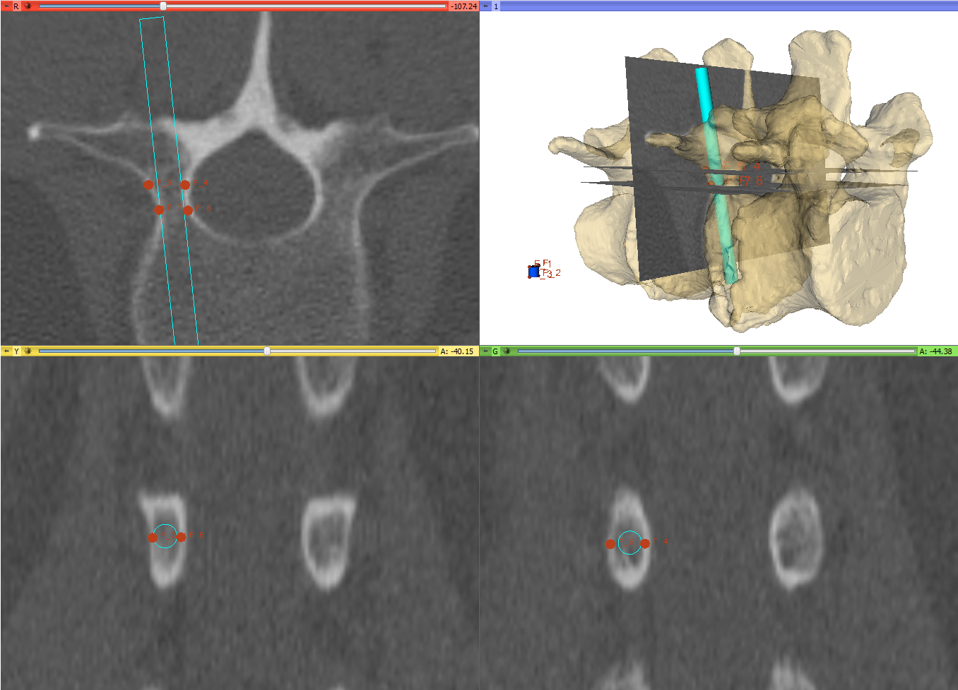
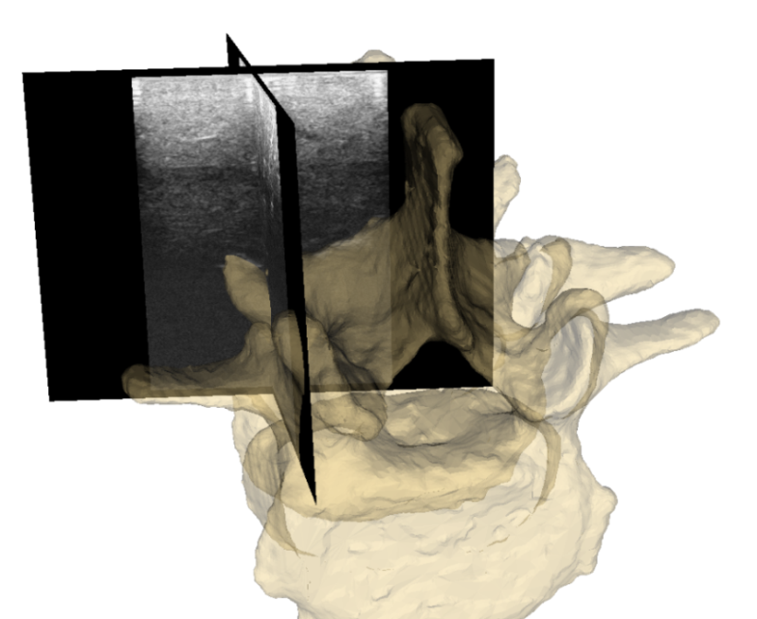
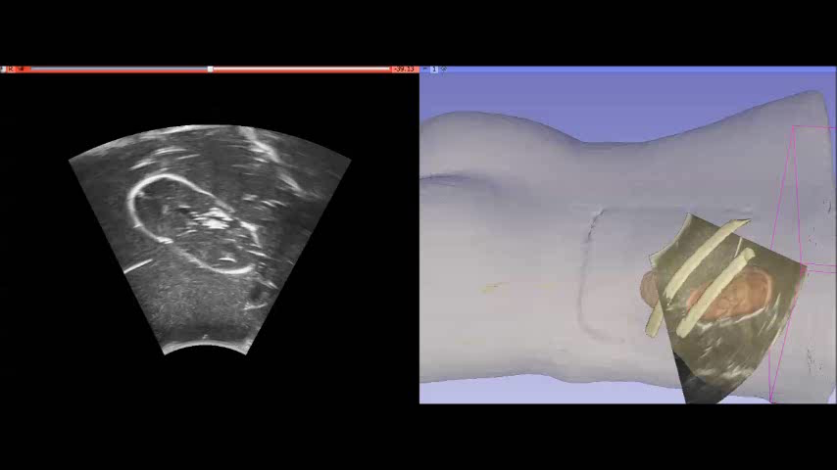
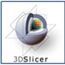
Guidance, visualization and planning
3D Slicer
www.slicer.org
Images and video by Tamas Ungi, MD, PhD

Slide 8
SlicerIGT layout
www.slicerigt.org
Navigation
computer
US machine
Position tracker
system
Reference tracking
sensor
Tracked US
transducer
Network
connection
Tracked needle
Patient
3D Slicer
SlicerIGT
PLUS software layer
Visualization
Tracking hardware
Synchronization
Tracker SDK
Registration
Calibration
Imaging hardware
OpenIGTLink
OpenIGTLink
Imaging SDK

Slide 9
Detailed architecture
Perk Tutor
ProstateNav
SlicerIGT
SlicerRT
Live ultrasound
...
Transform recorder
DICOM-RT import
...
Dose comparison
3D Slicer extension manager
3D Slicer
Registration
Segmentation
...
Visualization
VTK, ITK, CTK, QT, DCMTK, …
OpenIGTLink
Calibration, volume reconstruction, …
OpenIGTLink
PLUS
Video interface
Tracker interface
software
hardware
Ultrasound / video
Tracker system
MRI scanner
Robots, needle guides
www.slicerigt.org
www.plustoolkit.org
Custom phantoms

Slide 10
PLUS feature summary
Main concepts
Hardware abstraction: use exactly the same software w/ any hardware device
Documentation: document and share everything, specifications, user guides, tutorials, tips & tricks, file formats, CAD models, etc.
User & developer support: forum, email, remote desktop, house calls
Quality assurance: testing, issue tracking, releases
Software functions
Data acquisition from imaging and tracking devices (real, simulated, playback from recording) from any number of devices, synchronized
Automatic spatial and temporal calibration methods
Recording to memory / file
Live streaming to 3D Slicer (or other compatible app, via OpenIGTLink )
Remote control of streaming, recording, volume reconstruction functions from 3D Slicer (or other compatible app, via OpenIGTLink)
RF data processing: brightness conversion, scan conversion
Real-time Ultrasound simulation from segmented CT, MRI, etc. images
Volume reconstruction: real-time, with optional hole-filling

Slide 11
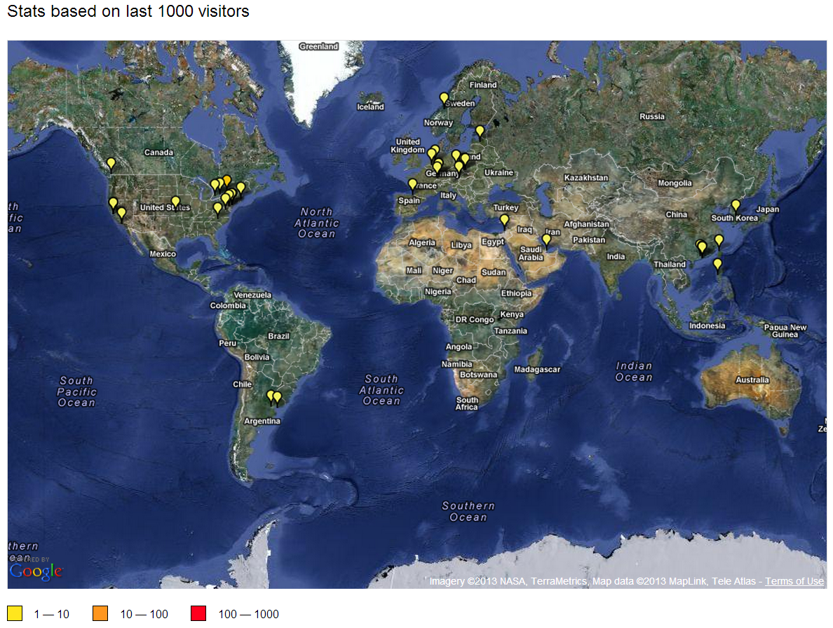
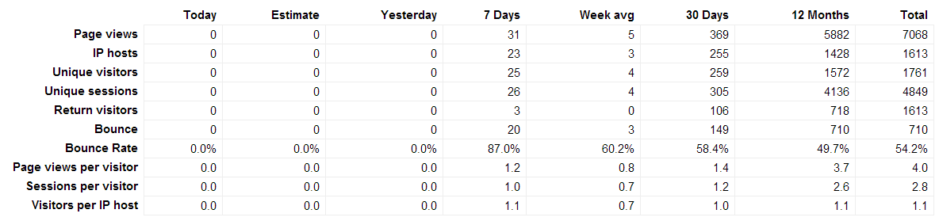
PLUS visitor stats

Slide 12

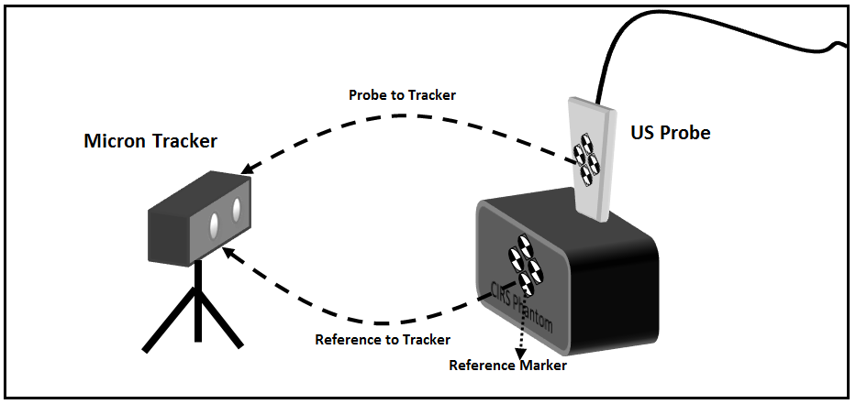
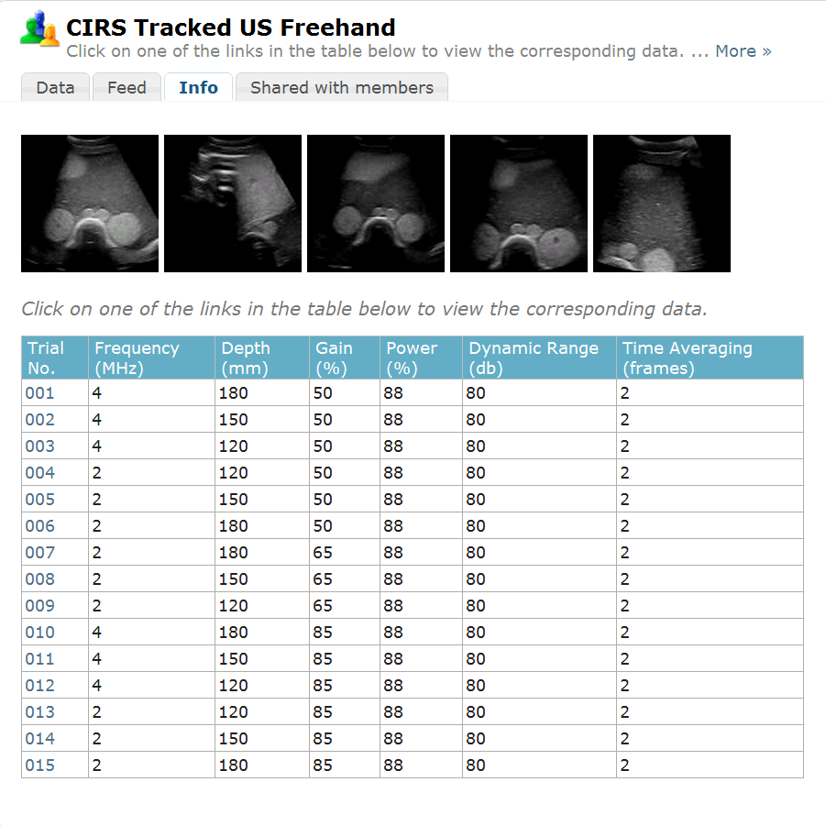
Public interventional US database
Public database US images of an abdominal Phantom acquired at different image acquisition parameters.
The database contains tracking information of the transducer in addition to the 2D ultrasound image slices.
PLUS gathers temporal and spatial calibration of the US and tracker, and captures the metaIO images in a format that records both the US image and the transducer position and orientation data.
Kitware: Vikas Revanna Shivaprabhu, Andinet Enquobahrie, Zach Mullen, Stephen Aylward

Slide 13

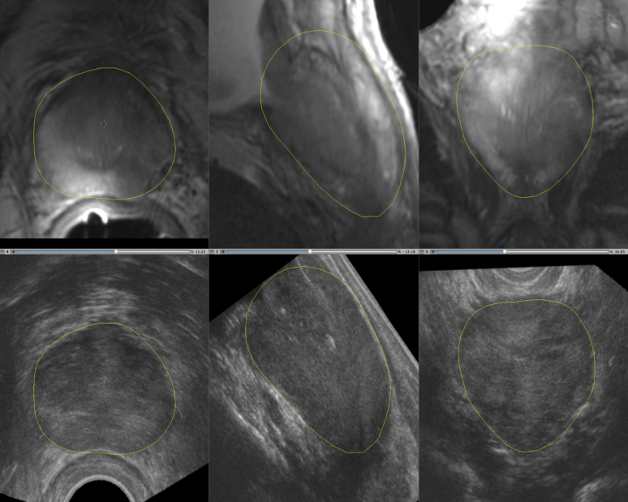
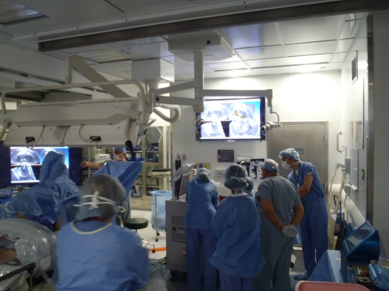
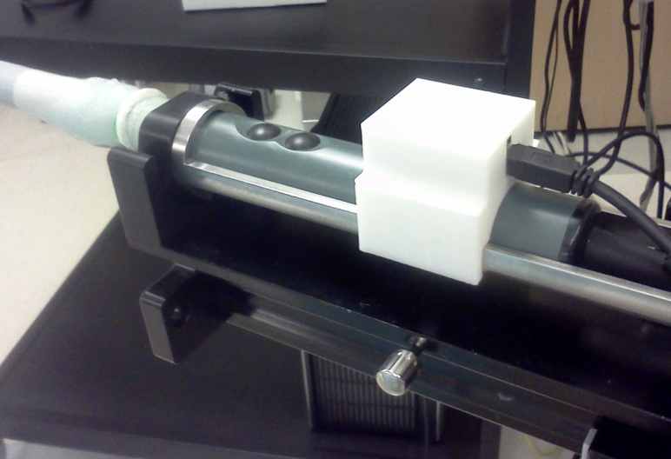

Prostate cancer interventions
BWH, UBC, and Queen’s
Integration of multi-parametric MRI with interventional TRUS for augmented display, tissue characterization and guidance.
PLUS: acquisition of rotation-tracked RF TRUS and ultrasound volume reconstruction
Distance transform applied to gland contours; distance maps were registered non-rigidly using BRAINS module of 3D Slicer.
Volume image acquisition in n>10 MR/US registration & fusion display in n=1 prostate brachytherapy.
BWH Rad: Fedorov, Kapur, Song Wells, Tempany; BWH Radonc: Neubauer Sugar, Nguyen; BK Medical: Robert Owen (R01 CA111288, PI Tempany).

Slide 14
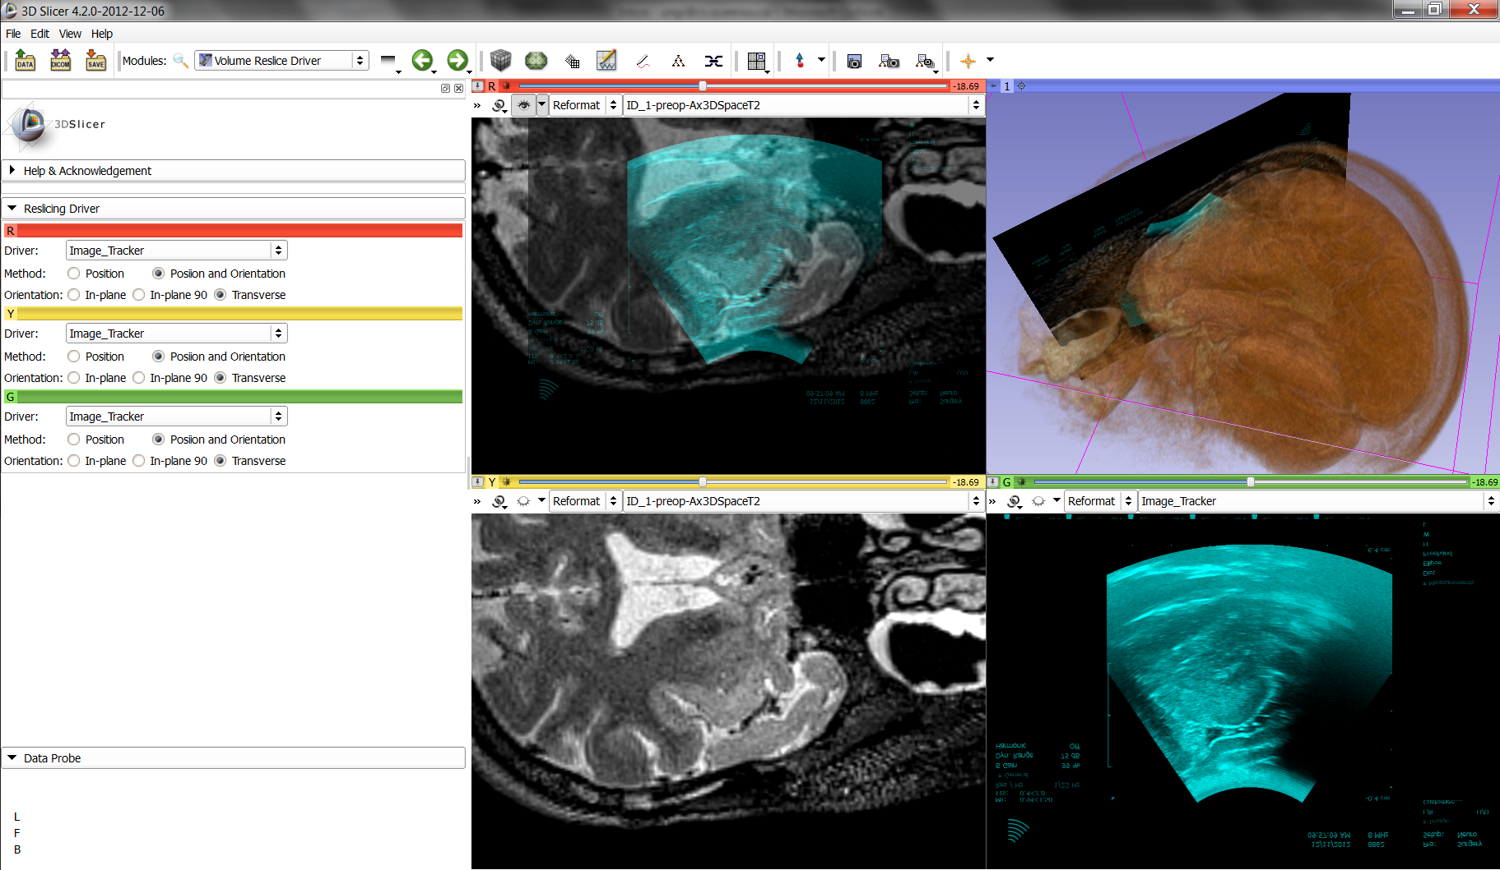
Brain surgery
Tracked US through the dura after opening the cranium
MRI volume is re-sliced at the US probe position;
Overlay of MR/US shows brain shift;
Volume rendered MR shows 3D context of the head
Brigham and Women’s Hospital: PI Wells and Aylward, Neurosurgeon Alexandra Golby, NIH Grant R01CA138419 on Image registration for ultrasound-based neurosurgical navigation
Notes:
Tracked US – of the Dura (after opening the cranium)
MRI volume is resliced according to US probe position
Left top: superimposed MR/US to show brain shift
Right top: volume rendered MR showing the head from the posterior side

Slide 15

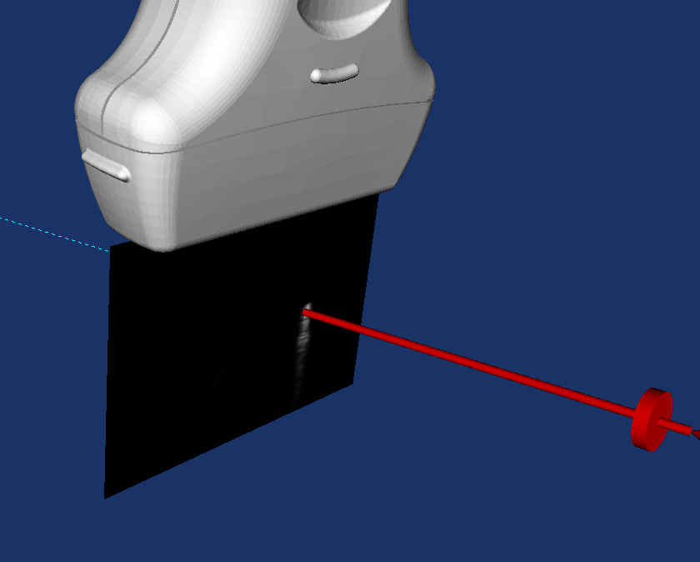

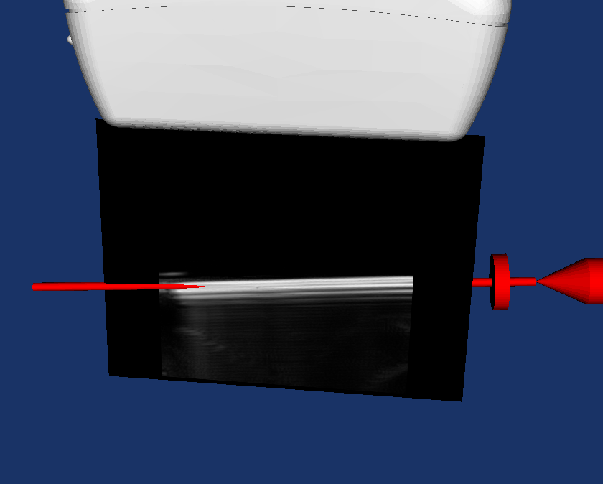
Central-line needle guidance
US-guided, elecromagnetically eagnetic-tracked central venous needle insertion system
PLUS is used for calibrating the ultrasound probe at various depths
Obtained Health Canada Approval, human trial is scheduled to begin shortly
Robarts Research Institute: Elvis Chen, Terry Peters, et al.
Notes:
US-guided, Magnetic-tracked Central venous needle insertion system
- obtained Health Canada Approval
- human trial is scheduled to begin within next month
Central venous insertion involves guiding a hallow needle into internal jugular vein for drug delivery, obtaining blood sample, or to obtain direct access into heart chamber. Such procedure is currently performed blindly (i.e. no guidance), relying solely on surgeon's experience and skills. US can be used to aid needle insertion, but the orientation of the vein, needle entry placement, and US beam, must be manipulated carefully by a single operator.
We propose an US-guided, magnetic-tracked, needle navigational system to aid such procedure. The system comprises of a magnetic tracking system, an US machine with calibrated probe, a magnetically tracked needle assembly, and a needle calibration block. The needle assembly comprises of the surgical needle/syringe, connected with a Luer Lok. A 6DOF magnetic sensor is attached to the Lure Lok, allowing the needle assembly to be tracked by the shaft of the assembly. The needle calibration block has the exact negative-imprint of the needle assembly and a 6DOF magnetic sensor, allowing the needle assembly to be registered/calibrated into the magnetic tracker space.
PLUS was used to calibrated the US probe at various depth. Due to the light-weight requirement of the software (it has to run on the Ultrasonix machine, with source-code to be peer-reviewed and fully tested), PLUS/SlicerIGT is not been used to streaming/visualization at this point. The spin-off projects based on this may be incorporated in the SlicerIGT environment in the future.

Slide 16
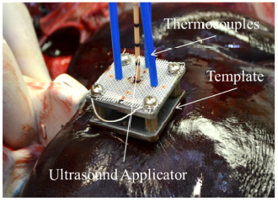
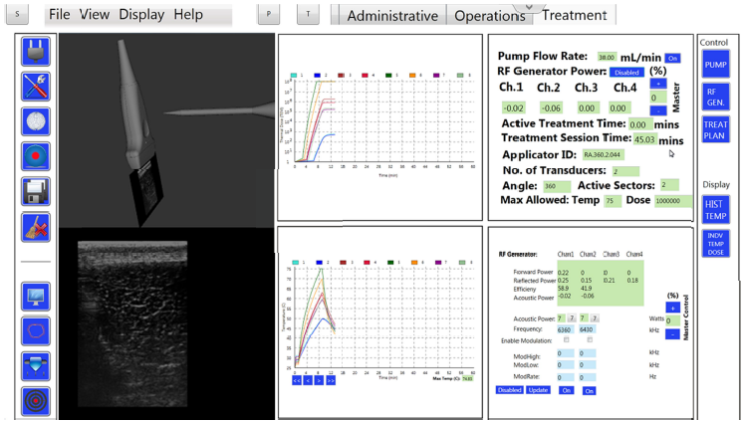
Interstitial HIFU liver ablation
PLUS is used for tracked ultrasound data collection
Prototyping of a commercial guidance system
Ghoshal et al., SPIE Medical Imaging, 2013
Acoustic MedSystems, Inc. (Savoy, IL, USA);
Dept. of Animal Sciences, University of Illinois (Urbana, IL, USA);
Dept. of Radiation Oncology, University of California (San Francisco, CA, USA)
Notes:
In situ treatment of liver using catheter based therapeutic ultrasound
with combined imaging and GPS tracking
Goutam Ghoshala, Tamas Hefftera, Emery Williamsa, Corinne Bromfieldb, Vasant Salgaonkarc,
Laurie Rundb, John M. Ehrhardtb, Chris J. Diederichc, E. Clif Burdettea*
aAcoustic MedSystems, Inc., Savoy, IL, USA
bDepartment of Animal Sciences, University of Illinois, Urbana, IL, USA
cDepartment of Radiation Oncology, University of California, San Francisco, CA USA
ABSTRACT
Extensive surgical procedure or liver transplant still remains the gold standard for treating slow-growing tumors in liver.
But only few candidates are suitable for such procedure due to poor liver function, tumors in unresectable locations or
presence of other liver diseases. In such situations, minimally invasive surgery may be the best therapeutic procedure.
The use of RF, laser and ultrasound ablation techniques has gained considerable interest over the past several years to
treat liver diseases. The success of such minimally invasive procedure depends on accurately targeting the desired region
and guiding the entire procedure. The purpose of this study is to use ultrasound imaging and GPS tracking system to
accurately place a steerable acoustic ablator and multiple temperature sensors in porcine liver in situ. Temperature
sensors were place at eight different locations to estimate thermal distribution in the three-dimensional treated volume.
Acoustic ablator of center frequency of 7 MHz was used for the experiments. During therapy a maximum temperature of
60-65 °C was observed at a distance 8-10 mm from the center of the ablation transducer. The dose distribution was
analyzed and compared with the gross pathology of the treated region. Accurate placement of the acoustic applicator and
temperature sensors were achieved using the combined image-guidance and the tracking system. By combining
ultrasound imaging and GPS tracking system accurate placement of catheter based acoustic ablation applicator can be
achieved in livers in situ.

Slide 17

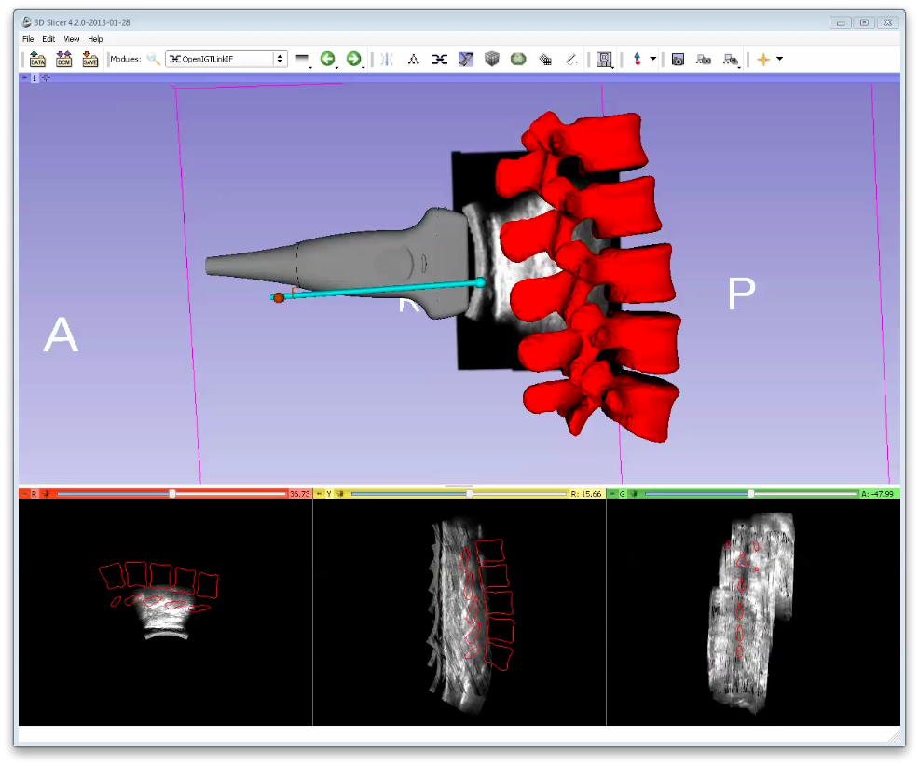
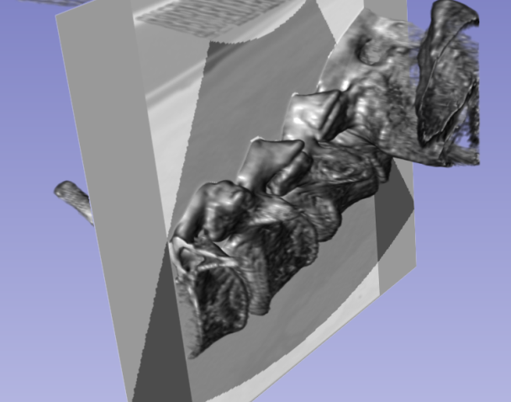
Spinal interventions
US-guided Spinal Interventions
Uses PLUS applications fCal and PlusServer
Records tracked US images, reconstructs US volumes
Needle guidance using the built 3D model and live US
Serves registration of CT-atlas to tracked US
Reslice of reconstructed volume
UBC: P. Abolmaesumi, R. Rohling, A. Rasoulian, S. Sojoudi, I. Hacihaloglu; Queen’s: P. Mousavi, S. Nagpal , T. Ungi.

Slide 18

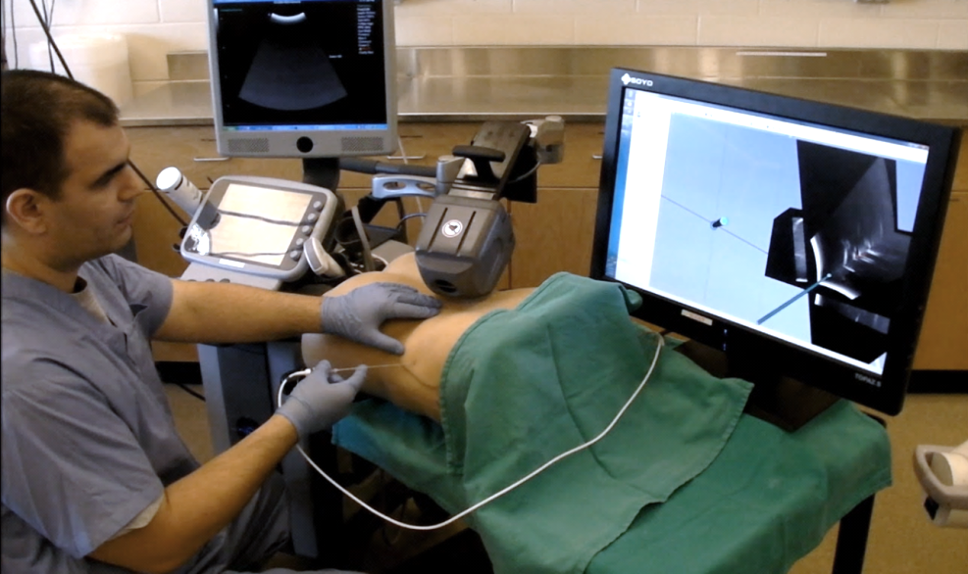
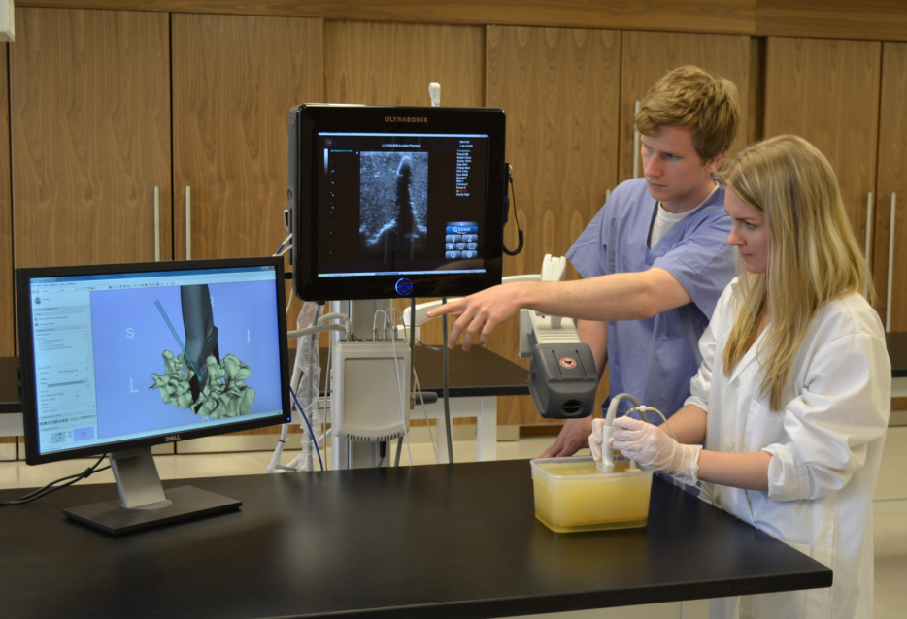
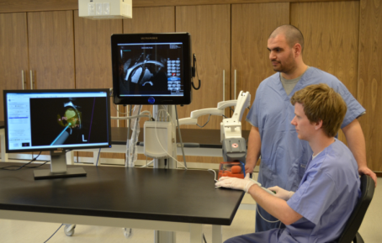
Perk Tutor training platform
Simulated training on phantoms
Quantitate skill acquisition and retention
Performance metrics
Open source software and hardware platform
Ungi et al., IEEE Trans Biomed Eng, 2012
Moult et al., IJCARS, 2013

Slide 19
Typical delivery times
Idea / first contact
2 weeks
4 weeks
6 weeks
8 weeks
10 weeks
12 weeks
First phantom experiment
Generic tracked US
(no new devices, SlicerIGT expert team)
Hardware setup (1 day)
Calibration (1 day)
Slicer scene setup (1 day)
First phantom experiment
Queen’s spine puncture
(custom phantom, SlicerIGT expert team)
Custom phantom from 3 patient CTs (manual segmentation, printing, gel making)
Calibration for all phantoms
First phantom experiment
Queen’s nephrostomy
(new phantom, SlicerIGT expert team)
Ordering phantom
Phantom imaging, hardware setup, scene setup (1 day)
First patient case
BWH prostate biopsy
(new imaging device, first project with PLUS)
adding BK ultrasound as an imaging device
testing, optimization
2012 June
2012 July
2012 September
First patient case
BWH brain surgery
(new tracking device, some experience with PLUS)
adding BrainLab as a tracker device, system setup, calibration
2012 Nov
2012 Dec
Start
Intermediate step
First patient/phantom case

Slide 20
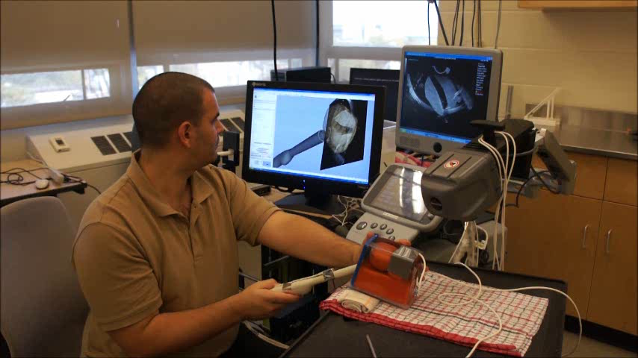
Take-home message
No platform
On platform
Each application is developed from scratch for each problem/procedure/device
Major work to implement new features
Huge waste of time/money/effort overall.
Core functions are already implemented
Many advanced algorithms are available
New modules developed for specific needs
Larger initial learning investment, but minimal wasted effort overall.

Slide 21
O Me! O Life!
“…
The question, O me! so sad, recurring—What good amid these, O me, O life?
Answer.
That you are here—that life exists, and identity;
That the powerful play goes on, and you will contribute a verse.”
Walt Whitman (1819 – 1892)

Slide 22






The PLUS team
Andras Lasso, PhD – lead software architect
Tamas Ungi, MD, PhD – systems developer
Csaba Pinter, Msc – systems developer
Tomi Heffter, MSc – systems developer
Adam Rankin, MSc – systems developer
CFI
PLUS http://www.plustoolkit.org
SlicerIGT http://www.slicerigt.org
Perk Lab http://perk.cs.queensu.ca

Slide 23
Appendix

Slide 24
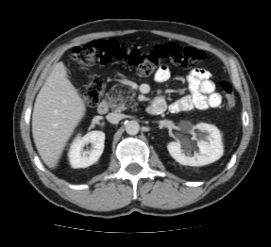
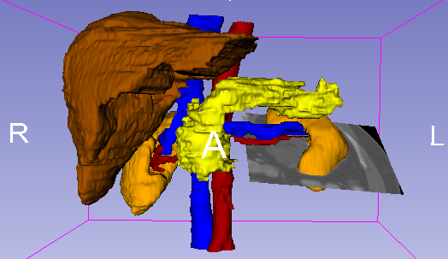
Navigation in abdominal surgery
Navigation in abdominal surgery
Unidad de Medicina y Cirugía Experimental, Hospital General Universitario Gregorio Marañón, Madrid, Spain
Surgical Planning Laboratory, Brigham and Women’s Hospital, Boston, USA
Navigation using 3D models (3D Slicer, http://www.slicer.org)
Actual scenario provided by Transcutaneus Ultrasound imaging
3D models obtained from a pre-operative CT image
Notes:
24

Slide 25
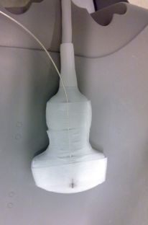
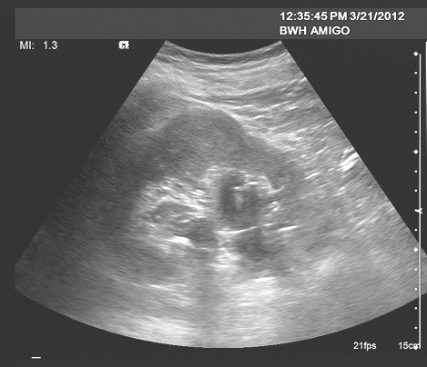
Navigation in abdominal surgery
T_{sensor}
T_{reg}
T_{calib}
Registration (Treg)?
Notes:
25

Slide 26
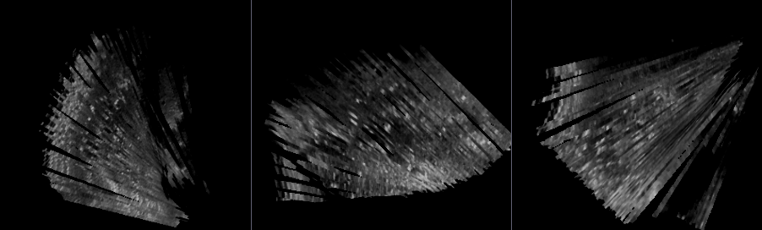

Navigation in abdominal surgery
Transcutaneus US-CT Registration:
Image US (3D) – Image CT (3D) registration
Create 3D US with Plus software (Queen's University)
Volume Reconstructor
https://www.assembla.com/spaces/plus/wiki/Volume_Reconstruction
MHA file with US images and US probe position (EM tracking)
Notes:
26

